Slide 1
Geotechnical analysis
Lecture objectives:
to define design requirements and objectives for any geotechnical
structure
to define methods of analysis that can be used in design of any
geotechnical structure

Slide 2
Geotechnical analysis
Lecture objectives:
to define design requirements and objectives for any geotechnical
structure
to define methods of analysis that can be used in design of any
geotechnical structure

Slide 3
Geotechnical analysis
Design requirements:
Basic geometry of the structure and loading conditions

Slide 4
Geotechnical analysis
Design requirements:
Basic geometry of the structure and loading conditions
Ground conditions, through geotechnical site investigation:
- soil stratigraphy
- soil strength
- soil stiffness
- ground water conditions

Slide 5
Geotechnical analysis
Design requirements:
Basic geometry of the structure and loading conditions
Ground conditions, through geotechnical site investigation:
- soil stratigraphy
- soil strength
- soil stiffness
- ground water conditions
Location of services:
- gas
- water
- electricity
- sewers
- tunnels

Slide 6
Geotechnical analysis
Design requirements:
Basic geometry of the structure and loading conditions
Ground conditions, through geotechnical site investigation:
- soil stratigraphy
- soil strength
- soil stiffness
- ground water conditions
Location of services:
- gas
- water
- electricity
- sewers
- tunnels
Type and depth of foundations of any adjacent buildings
old
d = ?
structure
new
structure
shallow
foundation
old
d = ?
structure
new
structure
piles

Slide 7
Geotechnical analysis
Design requirements:
Basic geometry of the structure and loading conditions
Ground conditions, through geotechnical site investigation:
- soil stratigraphy
- soil strength
- soil stiffness
- ground water conditions
Location of services:
- gas
- water
- electricity
- sewers
- tunnels
Type and depth of foundations of any adjacent buildings
Restrictions on performance of structure

Slide 8
Geotechnical analysis
Design objective: SAFE & STABLE structure
To achieve this objective, following must be investigated
through analysis:
Local stability
Overall stability
Structural forces
Movements

Slide 9
Geotechnical analysis
Design objective
Local stability
Original position
Deformed position
Retaining wall
Foundation

Slide 10
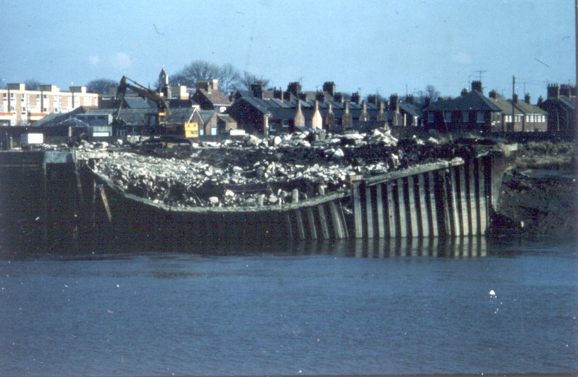
Geotechnical analysis
Design objective
Local stability
The houses in the back are stable
The wall has failed

Slide 11
Geotechnical analysis
Design objective
Overall stability
Slip
surface
Retaining wall is stable but slope is unstable

Slide 12
Geotechnical analysis
Design objective
Structural forces
- Bending moments
- Shear forces
- Axial forces
These must be obtained under both working
and ultimate conditions

Slide 13
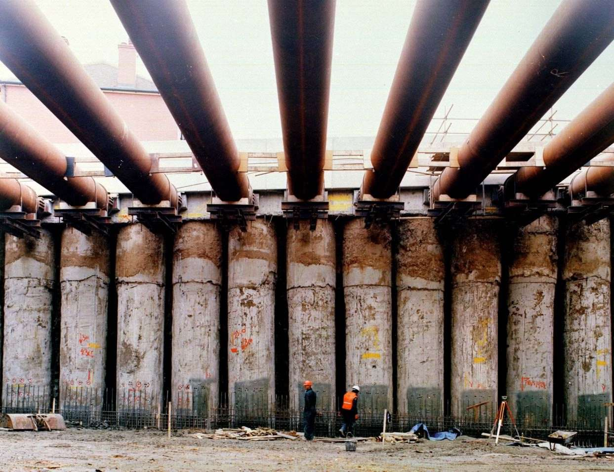
Geotechnical analysis
Design objective
Structural forces
Tubular pipes as props
Contiguous piles as retaining wall

Slide 14
Geotechnical analysis
Design objective
Movements
Movements of structures,
services and soil due to
new construction
(e.g. excavation) must be
determined
Services
Tunnel

Slide 15
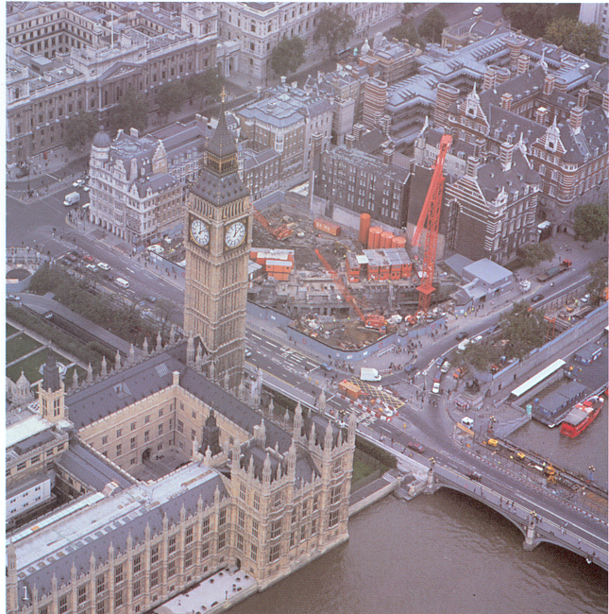
Geotechnical analysis
Design objective
Movements
Jubilee Line
extension
A
Big Ben clock
tower
Westminster
station excavation
A

Slide 16
Geotechnical analysis
Design objective
Movements
Big Ben
clock
tower
Other surrounding
buildings
New
Westminster
station
excavation
New Jubilee
Line tunnels
Cross-section A-A

Slide 17
Geotechnical analysis
Design objective: SAFE & STABLE structure
To achieve this objective, following must be investigated
through analysis:
Local stability
Overall stability
Structural forces
Movements

Slide 18
Geotechnical analysis
Lecture objectives:
to define design requirements and objectives for any geotechnical
structure
to define methods of analysis that can be used in design of any
geotechnical structure

Slide 19
Geotechnical analysis
Theoretical framework
Theoretical requirements for a solution from any
analysis method to be exact:
Equilibrium
Compatibility
Constitutive behaviour
Boundary conditions

Slide 20
Geotechnical analysis
Theoretical framework
Theoretical requirements for a solution from any
analysis method to be exact:
Equilibrium
Compatibility
Constitutive behaviour
Boundary conditions

Slide 21
Geotechnical analysis
Theoretical framework
Equilibrium
Inlet of water, Q
Trajectories of water flow
Outlet, Q1
Outlet, Q2
For equilibrium: Q = Q1 + Q2
Tank filled with sand

Slide 22
Geotechnical analysis
Theoretical framework
Equilibrium
Load, L
Stress trajectories
3
1
3
1
Reaction, L1=2L/3
Reaction, L2=L/3
For equilibrium: L = L1 + L2
Concrete beam

Slide 23
Geotechnical analysis
Theoretical framework
Equilibrium
Σ (Internal forces) = Σ (External forces)
stresses ?
self weight, point loads, UDL

Slide 24
Geotechnical analysis
Theoretical framework
Equilibrium
σ – direct stresses
τ – shear stresses
x
σ_{x}
y
τ_{xy}
τ_{yx}
τ_{xz}
τ_{zx}
σ_{y}
z
τ_{zy}
τ_{yz}
σ_{z}
γ – self weight acting in the
x-direction
3 equations & 6 unknowns

Slide 25
Geotechnical analysis
Theoretical framework
Theoretical requirements for a solution from any
analysis method to be exact:
Equilibrium
Compatibility
Constitutive behaviour
Boundary conditions

Slide 26
Geotechnical analysis
Theoretical framework
Compatibility
Physical presentation
Original geometry
Deformed geometry
Compatible deformation

Slide 27
Geotechnical analysis
Theoretical framework
Compatibility
Physical presentation
Original geometry
Deformed geometry
Non-compatible deformation

Slide 28
Geotechnical analysis
Theoretical framework
Compatibility
Mathematical presentation
x
u
Δ
v
6 equations &
9 unknowns
w
Δ
u
Δ
v
y
w
z
- direct strains
- shear strains

Slide 29
Geotechnical analysis
Theoretical framework
So far we have:
Unknowns
6 stresses + 6 strains + 3 displacements = 15 unknowns
Equations
3 equilibrium + 6 compatibility = 9 equations
We therefore need 6 more equations to be able to solve for
all unknowns

Slide 30
Geotechnical analysis
Theoretical framework
Theoretical requirements for a solution from any
analysis method to be exact:
Equilibrium
Compatibility
Constitutive behaviour
Boundary conditions

Slide 31
Geotechnical analysis
Theoretical framework
Constitutive behaviour
Describes material behaviour in terms of stress-strain relationship
σ
σ
σ
ε
ε
ε
Ductile behaviour
Strain softening
Strain hardening
Examples of stress-strain relationships in soils

Slide 32
Geotechnical analysis
Theoretical framework
Constitutive behaviour
- mathematical representation -
or:

Slide 33
Geotechnical analysis
Theoretical framework
Constitutive behaviour
- example of D matrix for linear elastic materials -
[D] =
where: E is the Young’s modulus
μ is the Poisson’s ration

Slide 34
Geotechnical analysis
Theoretical framework
Constitutive behaviour
- mathematical representation -
or:

Slide 35
Geotechnical analysis
Theoretical framework
Constitutive behaviour
reducing the number of parameters in a D matrix by
geometric idealisation
Simplification and/or idealisation of the geometry
and/or boundary conditions of the real geotechnical
problem

Slide 36
Geotechnical analysis
Theoretical framework
Constitutive behaviour
Geometric plane strain idealisation
x
y
Strip footing
z
Retaining
wall
Tunnel

Slide 37
Geotechnical analysis
Theoretical framework
Constitutive behaviour
Geometric plane strain idealisation – all x-y planes are similar
x
u
v
y
w
assumptions:
(1) w = 0
(2) u, v independent
of z-direction
z

Slide 38
Geotechnical analysis
Theoretical framework
Constitutive behaviour
Geometric plane strain idealisation

Slide 39
Geotechnical analysis
Theoretical framework
Constitutive behaviour
Geometric plane strain idealisation

Slide 40
Geotechnical analysis
Theoretical framework
Constitutive behaviour
Geometric plane strain idealisation

Slide 41
Geotechnical analysis
Theoretical framework
Constitutive behaviour
Geometric plane strain idealisation

Slide 42
Geotechnical analysis
Theoretical framework
Constitutive behaviour
Geometric plane strain idealisation
Reduction from 36 to 12 parameters in the D-matrix

Slide 43
Geotechnical analysis
Theoretical framework
Theoretical requirements for a solution from any
analysis method to be exact:
Equilibrium
Compatibility
Constitutive behaviour
Boundary conditions

Slide 44
Geotechnical analysis
Theoretical framework
METHOD
THEORETICAL REQUIREMENTS
OF
Equilibrium
Compatibility
Constitutive
Boundary Conditions
ANALYSIS
Behaviour
Force
Disp.
Closed Form
Linear
Elastic
Rigid with
Limit Equilibrium
a failure
criterion
Rigid with
Stress Field
a failure
criterion
Limit
L.B.
Ideal
Analysis
U.B.
Plasticity
Any
Full Numerical
Basic theoretical requirements satisfied by various methods of analysis

Slide 45
Geotechnical analysis
Theoretical framework
Method
Design requirements
of
Stability
Movements
Adjacent
structures
analysis
Closed form
(linear elastic)
Limit
equilibrium
Stress field
Limit
L.B.
analysis
U.B.
Crude
estimate
Full numerical
Design requirements satisfied by various methods of analysis

Slide 46
Geotechnical analysis
Theoretical framework
In this lecture we have:
identified main requirements and objectives for a design of any
geotechnical structure:
  assessment of local and overall stability
  estimate of structural forces
  estimate of ground movements and effect on existing structures
defined main theoretical requirements that a method of analysis
used in design must satisfy:
  equilibrium
  compatibility
  constitutive behaviour
  boundary conditions

